Slide 1
MCA Final Year Project (Review 111) AI-Powered Virtual Health Assistant
Submitted to the Presidency University, Bengaluru in partial fulfillment for the award of the degree of Master of Computer Applications(MCA)
Project Number : 222
Under the supervision of
Mr. Sakthi S Asst. Prof, Department of SCSE School of Computer Science and Engineering
Name | Roll Number
Latha Kamath M K | 20232MCA0058

Slide 2
Content
Problem Statement
Literature Survey
Module Design
Tools and Technologies to be used
Timeline of the Project
GitHub Link
References

Slide 3
Problem Statement
Healthcare Challenges: Overburdened systems, lack of expertise in remote areas, high costs, and privacy concerns.
Limitations of Traditional Services: Long waiting times, limited doctor availability, and poor medical record management.
Many individuals frequently experience health symptoms but lack quick and reliable access to medical insights.
The goal of this project is to create an intelligent assistant that can guide users with accurate predictions and health recommendations using AI and machine learning.
Accessibility and Affordability: Web and mobile apps for convenient, efficient, and affordable healthcare.

Slide 4
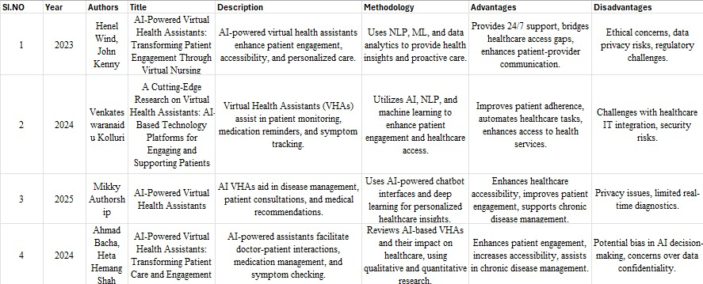
Literature Review

Slide 5
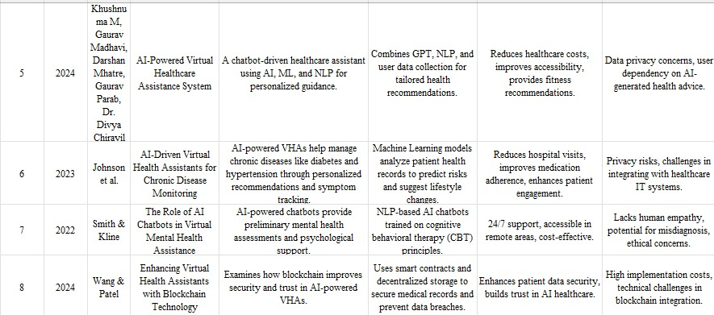

Slide 6
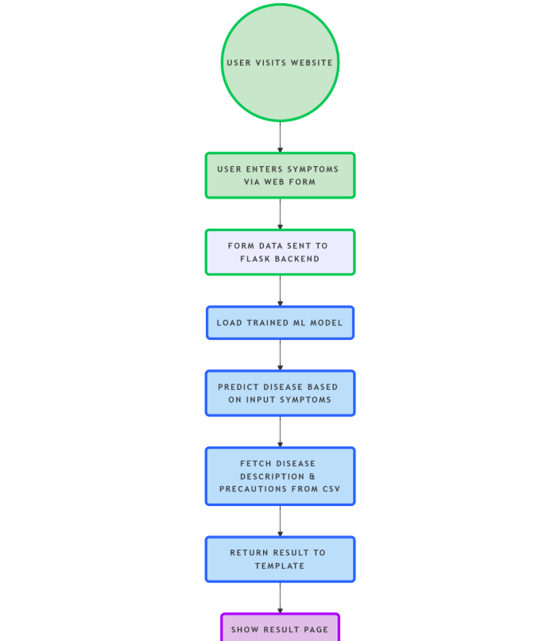
Module Design

Slide 7
User Visits Website → The user opens the web application to access the symptom checker.
User Enters Symptoms via Web Form → The user inputs symptoms through a frontend form on the homepage.
Form Data Sent to Flask Backend (/home) → The submitted form data is routed to a Flask endpoint for processing.
Load Trained ML Model (model.pkl) → The backend loads a pre-trained machine learning model using pickle.
Predict Disease Based on Input Symptoms → The model predicts a probable disease based on the user's input.

Slide 8
6. Fetch Disease Description & Precautions from CSV → Descriptive and precautionary information is retrieved from a dataset.
7. Return Result to Template (disease, desc, precautions) → The backend sends the prediction and details to the frontend template.
8. Show Result Page (index.html updated) → The final prediction and advice are displayed back to the user.

Slide 9
Modular Breakdown
Module 1: User Interface (Frontend)
Function: Provides an HTML-based frontend (index.html, about.html, etc.) for users to input symptoms and view results.
1. User Interface Module (Frontend UI)
Provides a clean and responsive interface using Bootstrap 5.
Allows users to input symptoms via text or voice.
Includes a main form with a “Predict” button for AI analysis.
Displays results in modals for disease, medications, diet, etc.
Features a consistent navigation bar across all pages.
Ensures intuitive interaction and a smooth user experience.

Slide 10
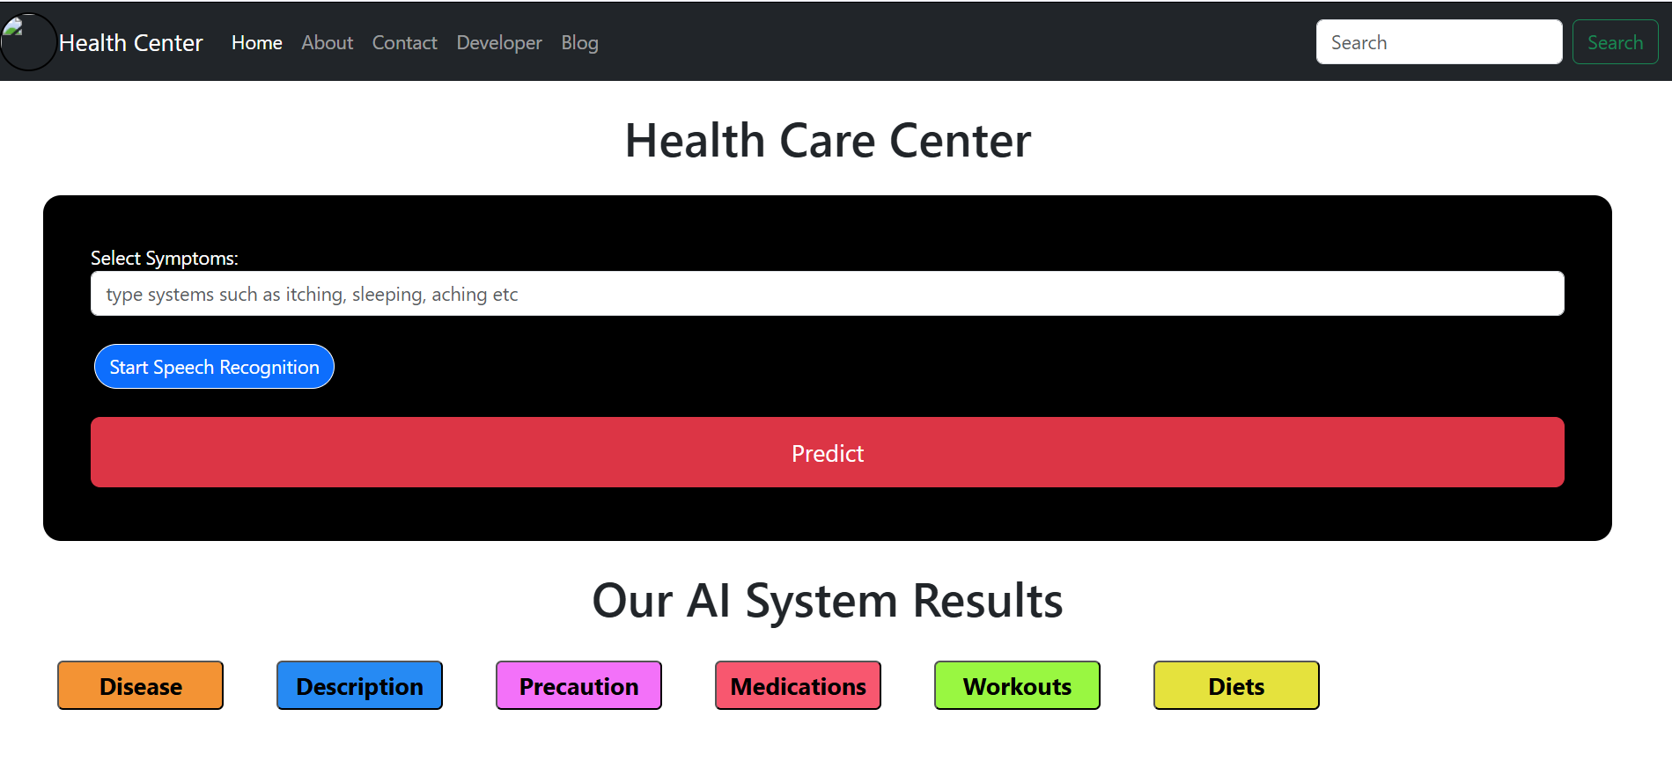

Slide 11
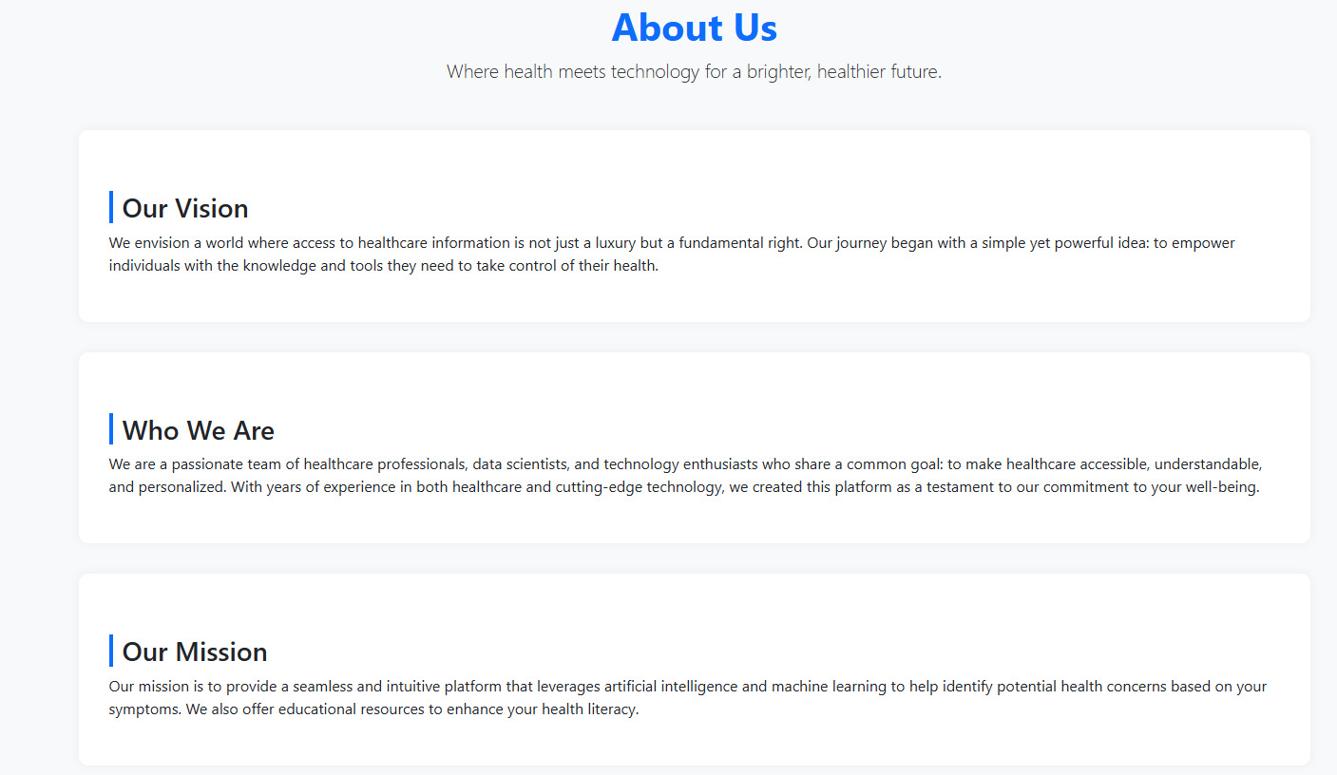
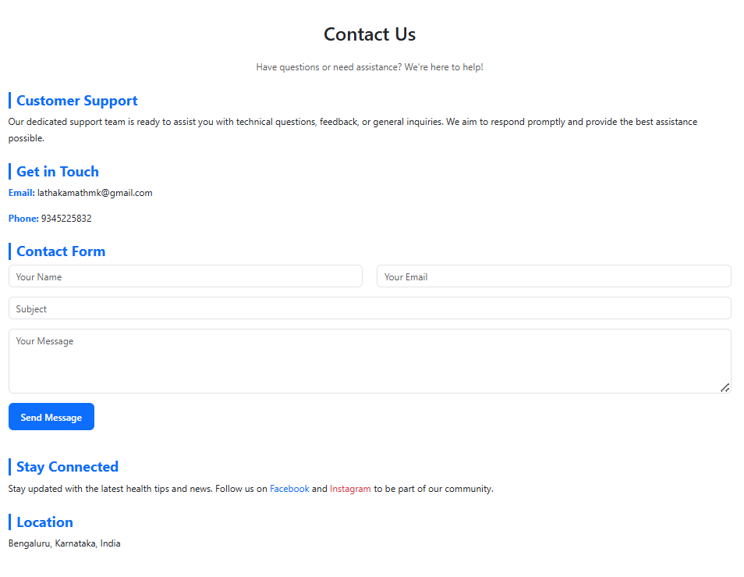

Slide 12
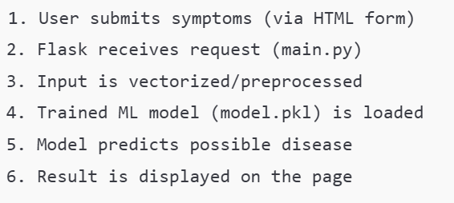
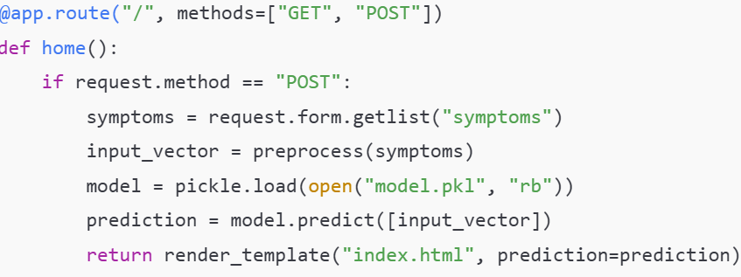
Module 2: Backend Processing & Prediction
Function: Uses Flask (main.py) to handle requests, process input, load the trained ML model, and predict the disease based on user symptoms.

Slide 13
3. Machine Learning Model Module
A pre-trained ML model (e.g., DecisionTreeClassifier, RandomForest) is used.
The model was trained on a symptoms-disease dataset (CSV).
It predicts disease based on user input.

Slide 14
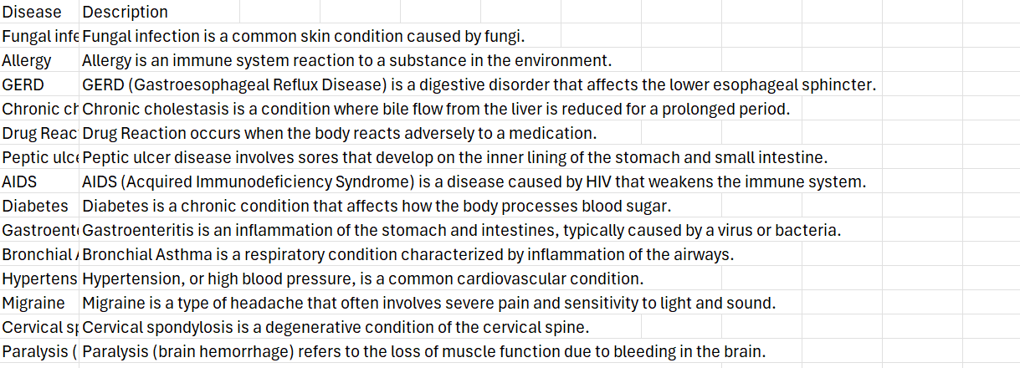
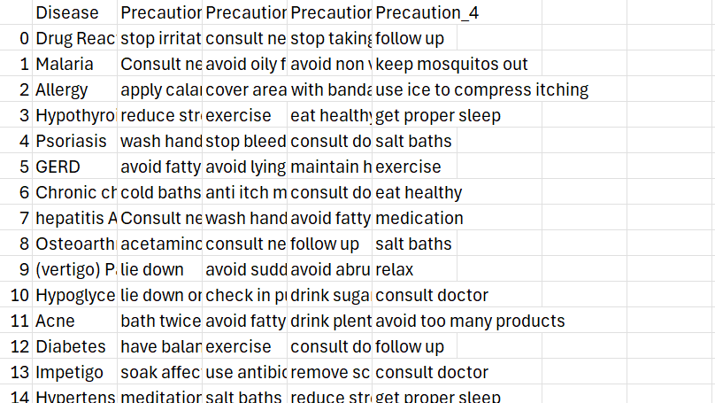
4. CSV Lookup Module
After prediction, additional info like description and precautions is fetched from CSV.
This enriches the user experience with useful health advice.
Python’s pandas is used to fetch and display relevant rows.

Slide 15
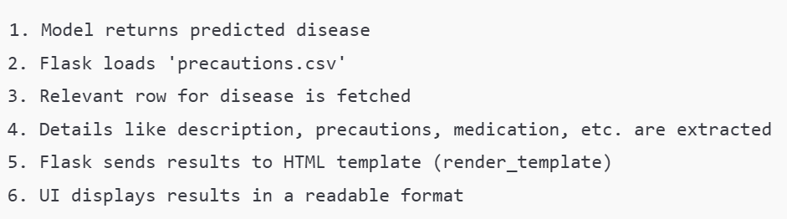
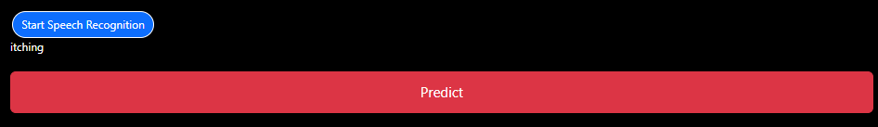
Module 5: Output Rendering & Information Display
Function: Retrieves relevant health data (description, precautions) from precautions.csv and displays prediction results and advice on the frontend.

Slide 16
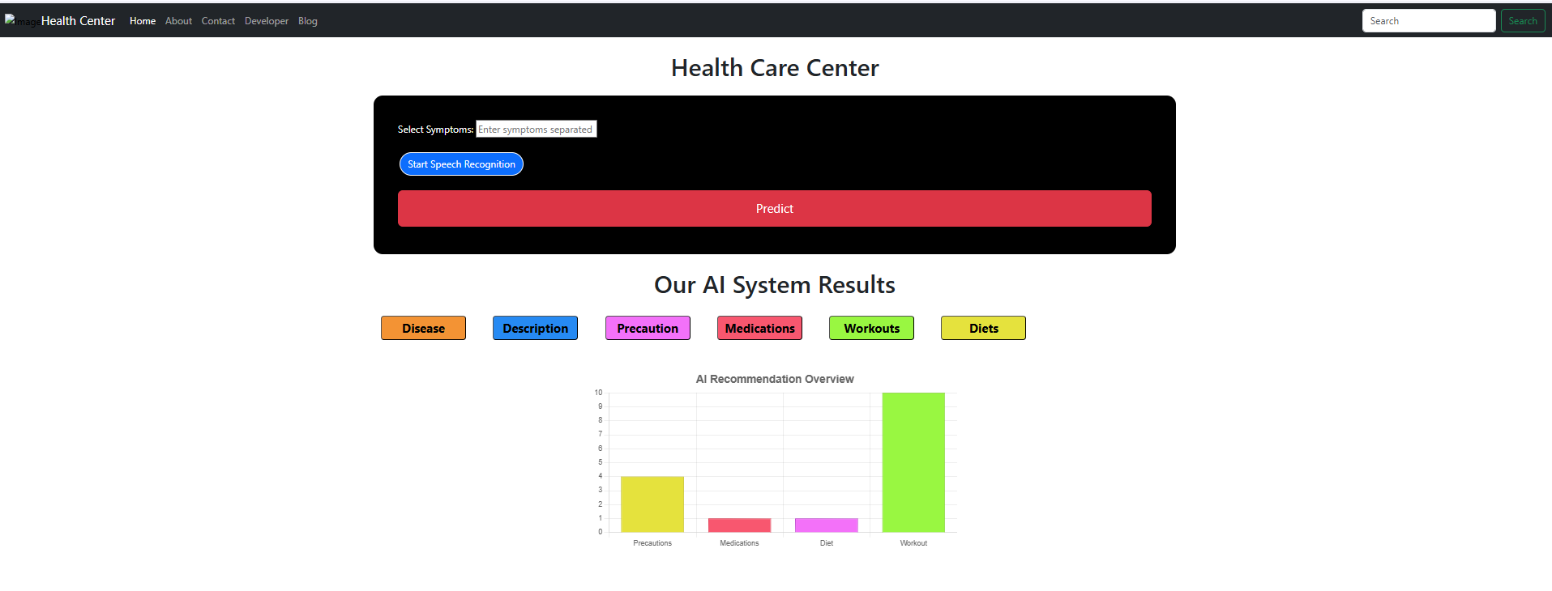
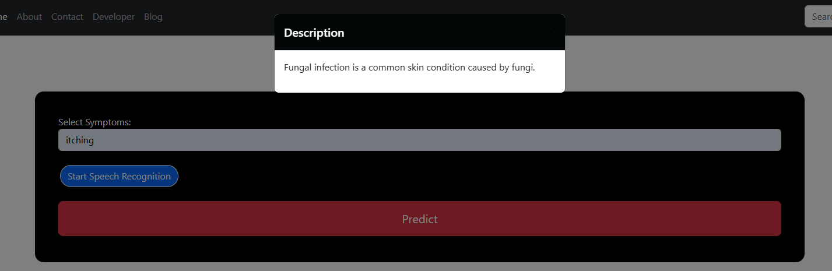

Slide 17
Tools And Technologies To Be Used
Flask:
Backend web framework for handling HTTP requests and routing.
Python:
Core programming language for backend logic and machine learning integration.
Pandas:
For reading and processing structured data from CSV files.
Scikit-learn / Trained ML Model:
Used for making disease predictions based on symptoms.
HTML, CSS, Bootstrap:
For designing a responsive and styled frontend interface.

Slide 18
Jinja2:
Templating engine for dynamic rendering of prediction results on HTML pages.
CSV Files:
Contain symptom-disease mappings, disease descriptions, and precautions.
PyCharm:
Integrated Development Environment (IDE) for developing and debugging the application.
Virtual Environment (venv):
For managing project-specific dependencies and isolating the development environment.

Slide 19
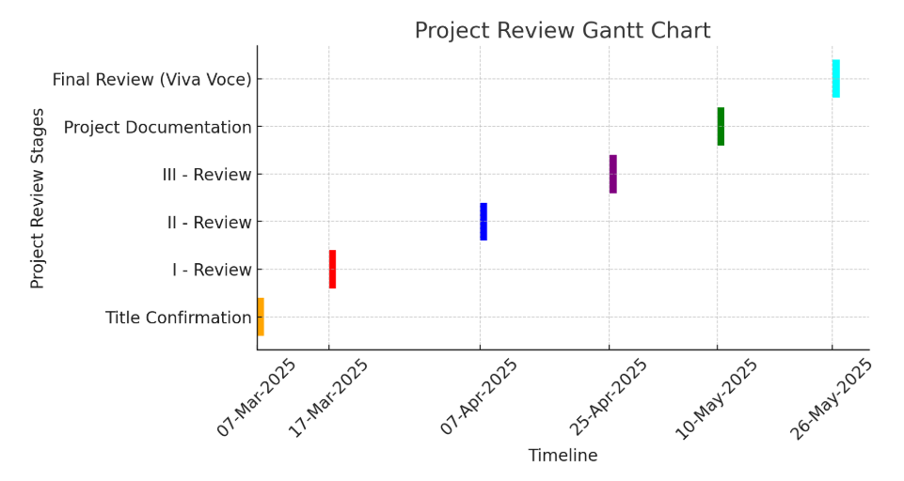
Timeline of the Project

Slide 20
GitHub Link
Lathakamathmk/AI-Powered-Virtual-Health-Assistant- · GitHub

Slide 21
References
1. H. Wind and J. Kenny, "AI-Powered Virtual Health Assistants: Transforming Patient Engagement Through Virtual Nursing," 2023.
Discusses AI-powered virtual health assistants' role in enhancing patient engagement and personalized care using NLP, ML, and data analytics.
2. V. Kolluri, "A Cutting-Edge Research on Virtual Health Assistants: AI-Based Technology Platforms for Engaging and Supporting Patients," 2024.
Explores how AI-driven VHAs assist in patient monitoring, medication reminders, and symptom tracking through AI, NLP, and machine learning.
3. M. Authorship, "AI-Powered Virtual Health Assistants," 2025.
Examines AI-driven VHAs in disease management, consultations, and medical recommendations with chatbot-based interactions and deep learning.
4. A. Bacha and H. H. Shah, "AI-Powered Virtual Health Assistants: Transforming Patient Care and Engagement," 2024.
Reviews AI-based VHAs for improving doctor-patient interactions and chronic disease management using qualitative and quantitative research.

Slide 22
K. M., G. Madhavi, D. Mhatre, G. Parab, and D. Chiravil, "AI-Powered Virtual Healthcare Assistance System," 2024.
A chatbot-driven AI-powered healthcare assistant integrating GPT, NLP, and ML for personalized health recommendations.
6. Johnson et al., "AI-Driven Virtual Health Assistants for Chronic Disease Monitoring," 2023.
Investigates AI-powered VHAs for managing chronic diseases such as diabetes and hypertension using ML-based patient record analysis.
7. Smith and Kline, "The Role of AI Chatbots in Virtual Mental Health Assistance," 2022.
Focuses on NLP-based AI chatbots trained on cognitive behavioral therapy (CBT) principles for mental health support.
8. Wang and Patel, "Enhancing Virtual Health Assistants with Blockchain Technology," 2024.
Examines the integration of blockchain technology for security and trust in AI-powered VHAs using smart contracts and decentralized storage.

Slide 23


